Slide 1
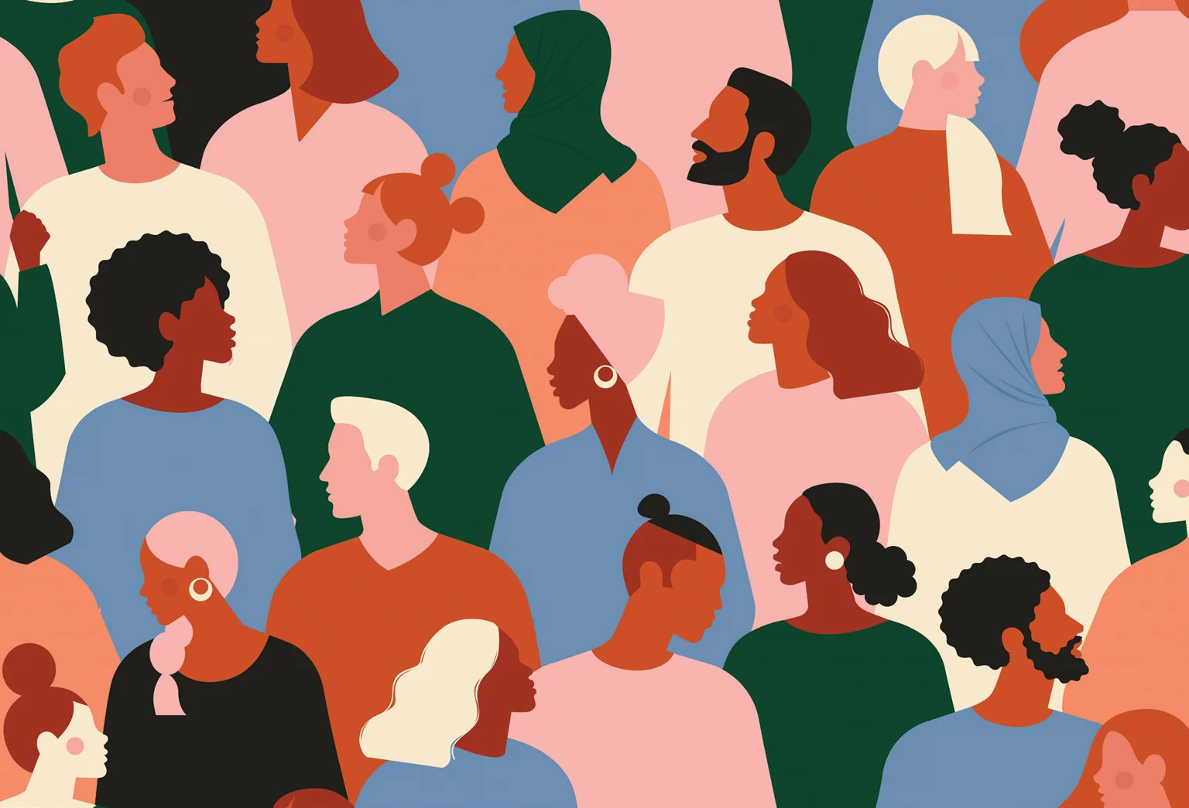
Unit 3 Synthesis Artifact
By: Anonymous SED 101 Student
Lyubov, Ivanova (2018). How To Think About ‘Implicit Bias’, Scientific American.

Slide 2
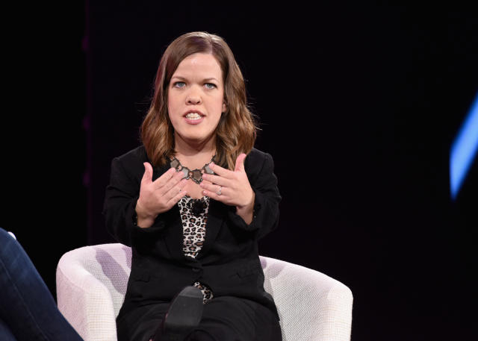
Ableism
Ableism is when people with disabilities are often seen as needing “fixed”, and they are disvalued and discriminated against.
Ableism can be seen in how the U.S. government has dealt with state funding for disabled kids' services.
The idea of ableism in very present in social settings and is often caused by stereotypes that people have about what disability looks like.
This introduces the idea of disability being a “continuum”
Leah Smith, who wrote an article about ableism, discussed how people would constantly ask about her medical history as though it should be public knowledge.
Killilia, Vivien (2019). How little person Leah Smith is teaching her average-sized daughter, 2, to love her body, Makers.
Leah Smith

Slide 3
Implicit Bias
Commonly linked with ideas of racism, sexism, and classism
Implicit bias is how the brain has developed prejudices and preconceived opinions about different groups of people.
This is strongly influenced by ideas of normalcy and other factors such as “societal worth”.
A lot of times people can have biases they do not even know about; these are called unconscious biases.
Having an unconscious bias is usually formed by what you were taught in your family growing up or even in educational settings.

Slide 4
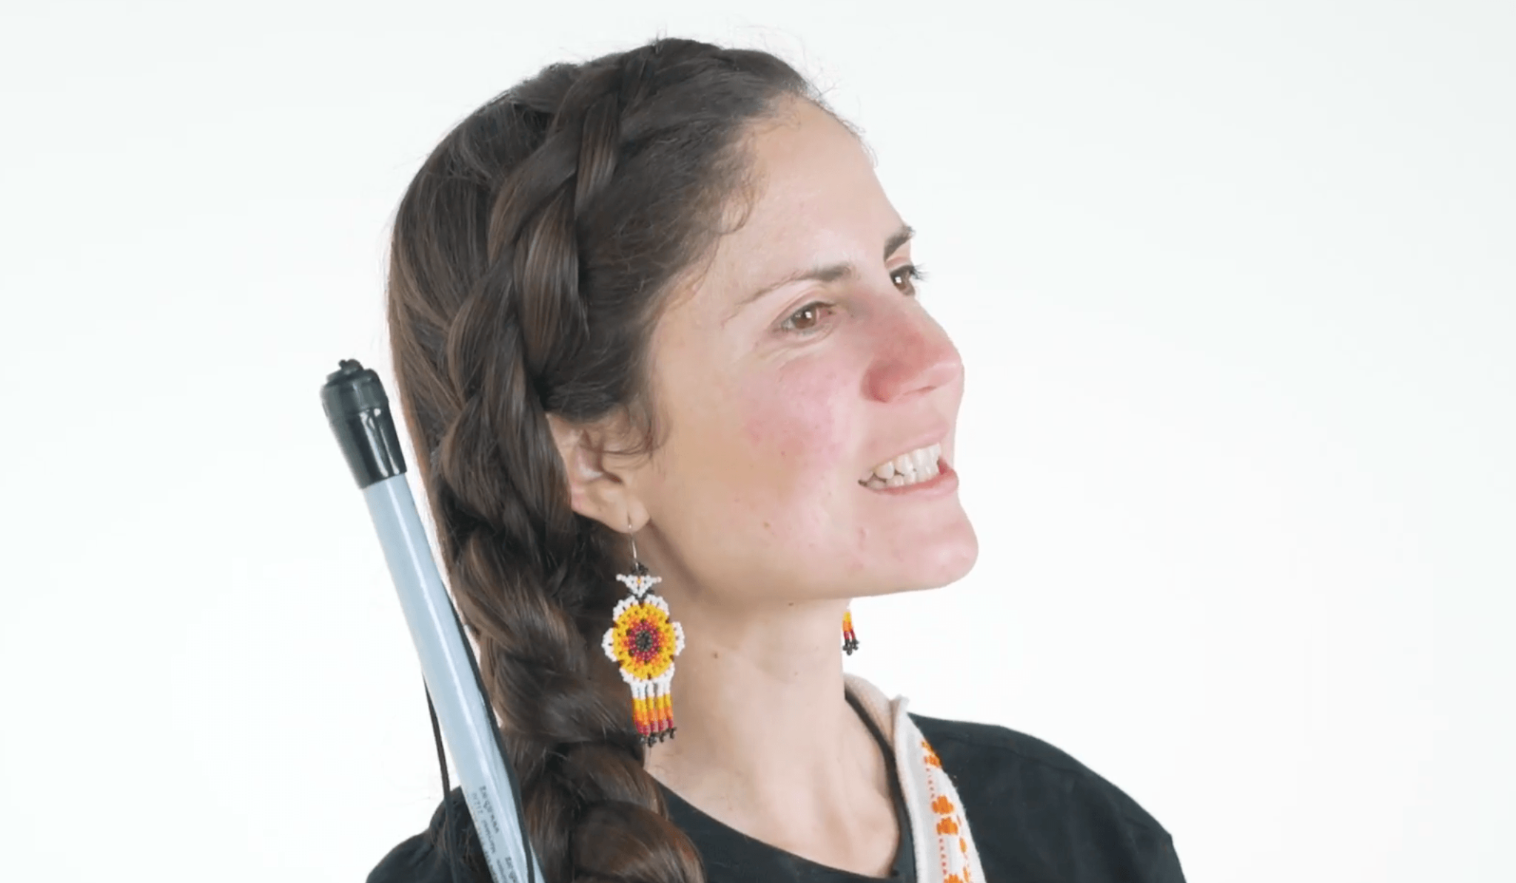
Intersectionality
Intersectionality is when discrimination on multiple levels is combined/overlaps
A good Engage source that discussed this was Conchita Hernandez. She is blind and Latina, so faces a lot of discrimination daily for multiple things.
Intersectionality is very harmful and can even feel unlivable at times, because people cannot exist without feeling discriminated against.
Awareness helps with this issue and should continue to be spread
(2018). Una Tarde Con Chita, Lighthouse.

