Slide 1
Chronic Diseases of Aging that Shorten Lifespan
“But who pretends that life is one slowly ascending curve of human development? Most of the time you have to smash into something: The death, the broken relationship, the horrible career moment. Then you think, Well, what matters to me? What do I enjoy? Or even just, I’m still here." – Kenneth Branagh (British actor and filmmaker, NYTimes, 11.01.2021)

Slide 2
Why Do We Age?
In 1957, George Williams (1926-2010, evolutionary biologist) proposed a major theory of aging. It’s called antagonistic pleiotropy.
In a nutshell, antagonistic pleiotropy is when one gene controls for more than one trait (pleiotropy), where at least one of those traits is beneficial to the organism’s fitness early in life and at least one is detrimental to the organism’s fitness later in life due to a decline in the force of natural selection. If you remember from biology class, natural selection is one of the driving forces of evolutionary change.

Slide 3
Why Do We Age? - 2
For example, if a gene caused both increased reproduction in early life and aging in later life, then senescence (senility; getting older) would be adaptive in evolution.
Thus, follicular depletion in human females—follicular depletion of the female’s ovaries and loss of follicular activity—causes both regular menstrual cycles early in life and loss of fertility later in life, known as menopause.
Thus, it was selected for in human evolution by having its early benefits outweigh its late costs.

Slide 4
Why Do We Age? - 3
So, genes select for reproductive and fitness advantages early in life but are “antagonistic” to development in later life. Thus, aging is essentially “programmed” into the organism.
But that’s not the whole story. Development across the lifespan actually plays a large part in all this.

Slide 5
Why Do We Age? - 4
A hallmark of organismal aging–-humans, in our case–-is the proliferation of growth-promoting pathways from childhood and adolescence into middle age that are no longer useful and have become hyperfunctional, that is, over-productive and increasingly useless.
Or to put it another way, as we age cell division throughout the body and brain slows down. However, growth-promoting pathways from our childhood and adolescence continue throughout the body and brain converting these now non-proliferating cells to a senescence state, a process called “geroconversion.”

Slide 6
Why Do We Age? - 5
But, as a result, these cells are rendered hypertrophic (enlarged) and hyperfunctional (continue to operate but with no clear purpose). This is known as the "hyperfunction theory of aging.”
However, it turns out that there are ways to inhibit geroconversion and extend human and animal “healthspan”–-as well as lifespan–-by turning off major aging pathways in the body. But that is a discussion for another time.
What are some of the negative effects of geroconversion? Cancer is a big one, but here we will look at other deleterious effects leading to aging in later life.

Slide 7
Aging and Longevity
If we look at brain changes over the lifespan, notice what’s decreasing from adolescence (see diagram): Grey matter volume, cortical thickness, cerebral volume, and the surface area of the cortex, all of which have to do with thinking, problem-solving, and memory.
From adolescence on, the brain is literally shrinking. White matter connections begin to decrease in middle-age, which connect all of those areas for thinking and memory to each other and are responsible for humans’ incredibly diverse intelligences, abilities, and skills.

Slide 8
Brain Changes Across the Lifespan

Slide 9
Neurodevelopmental Disorders and Disease
Neurodevelopmental disorders like autism (ASD), problems with attention (ADHD), anxiety (ANX), mood disorders (MDD/BD), and schizophrenia (SCZ) are rampant in early life. Why these disorders of development in childhood and adolescence?
Well, for one thing, your “genome”–-the 23 pairs of chromosomes that are the blueprint of your future–-can be mis-programmed from the start (no blueprint is perfect) and the programming of these genes can easily go astray during development due to both internal programming errors (there are up to 50,000 genes on these 23 chromosome pairs with over 3.1 billion base pairs of DNA) as well as extensive external insults from the environment during development such as childhood diseases; childhood abuse; exposure to alcohol, tobacco, and illicit drugs; neurotoxicants such as lead and arsenic, and so on. Lots can go wrong.

Slide 10
Chronic Diseases of Aging
Moreover, modern humans are “wired” for a quick ascent and a slow decline (see diagram).
As a result, aging is now thought of as a disease resulting in a potpourri of chronic diseases and disorders of aging like diabetes, hypertension, obesity, osteoarthritis, osteoporosis, cataracts, macular degeneration, benign prostatic hyperplasia (BPH), cardiovascular disease, cancer, periodontal disease, and dementia including Alzheimer’s and Parkinson’s diseases.

Slide 11
Modern Humans are “Wired” for a Quick Ascent and a Slow Decline

Slide 12
Neurodegenerative Diseases and Disorders
The standard model of Alzheimer’s disease (AD)–-the most common neurodegenerative disease—postulates that the production of the amyloid-β (Aβ) peptide (peptides are short chains of amino acids that form proteins), stimulates the development of tau neurofibrillary tangles (tau is a protein composed of larger chains of amino acids that stabilize axons that interact with neighboring neurons) as well as inflammation in the brain or “neuroinflammation.” Thus, Aβ, tau, and neuroinflammation have been proposed to lead to the destruction of neurons and synapses in the adult brain in AD.

Slide 13
Neurodegenerative Diseases and Disorders - 2
A new theory, however, suggests that infections of both the brain and body triggers the immune system in the brain and that sets off neuroinflammation. What kind of infections? Microbes that attack the brain, known as neurotropic microbes, include the family of herpes viruses including herpes simplex virus 1 (HSV-1) and 2 (HSV-2), which cause cold sores (herpes labialis) and genital herpes, respectively. In the US, about half of adolescents and adults under the age of 50 are infected with HSV-1 and about 12% are infected with HSV-2. As it turns out, antivirals such as Acyclovir reduce the accumulation of both Aβ and tau in the brain lending credence to the centrality of these peptides and proteins in neurodegeneration.

Slide 14
Neurodegenerative Diseases and Disorders - 3
But there are other neurotropic microbes linked to AD including the varicella-zoster virus (VZV) implicated in chickenpox and shingles and also widespread in the US population. There is also the hepatitis C virus implicated in liver disease, Helicobacter pylori associated with gastric ulcers, Porphyromonas gingivalis, a bacterium associated with periodontal disease, Chlamydia pneumoniae, a bacterium linked to pneumonia, as well as diverse fungal infections.

Slide 15
Neurodegenerative Diseases and Disorders - 4
Moreover, there are actually two immune systems in humans. The innate immune system and the adaptive or “acquired immune system.” When pathogens invade the brain and body, the innate system initiates inflammation, which attempts to eliminate cell injury, clear necrotic cells and damaged tissues from the body, and initiate tissue reparation. We find this system, of course, in young infants. But as we age, the acquired immune system kicks in as the immune system learns about the specifics of new pathogens and develops defenses against them such as lymphocytes that produce antibodies.

Slide 16
Neurodegenerative Diseases and Disorders - 5
However, chronic inflammation caused by the acquired immune system can lead to a bevy of diseases of aging including atherosclerosis, osteoarthritis, periodontal disease leading to gum recession and tooth loss, as well as disorders of the brain itself. What are some of these disorders that affect the central and peripheral nervous systems and may be affected by chronic inflammation (see diagram)? Friedreich’s ataxia (FRDA) is a genetic, progressive, neurodegenerative movement disorder. Huntington’s disease (HD) is also a genetic, hyperkinetic movement disorder. Frontotemporal disorder (FTD) is a dementia of the frontal and temporal lobes.

Slide 17
Neurodegenerative Diseases and Disorders - 6
Bruce Willis, the actor, was recently diagnosed with FTD, originally thought to be Wernicke’s or semantic aphasia, that is, the inability to understand language. Yet, amyotrophic lateral sclerosis (ALS) involves progressive loss of motor neurons that control the voluntary musculature. Alzheimer’s disease’s (AD) early symptoms include problems with memory for events known as “episodic memory.” Finally, Parkinson’s disease (PD) includes tremor, bradykinesia (slow movements), muscle rigidity, as well as problems in initiating movement. In a second set of posts on aging, I'll discuss social, cultural, and interpersonal factors that may delay aging...

Slide 18
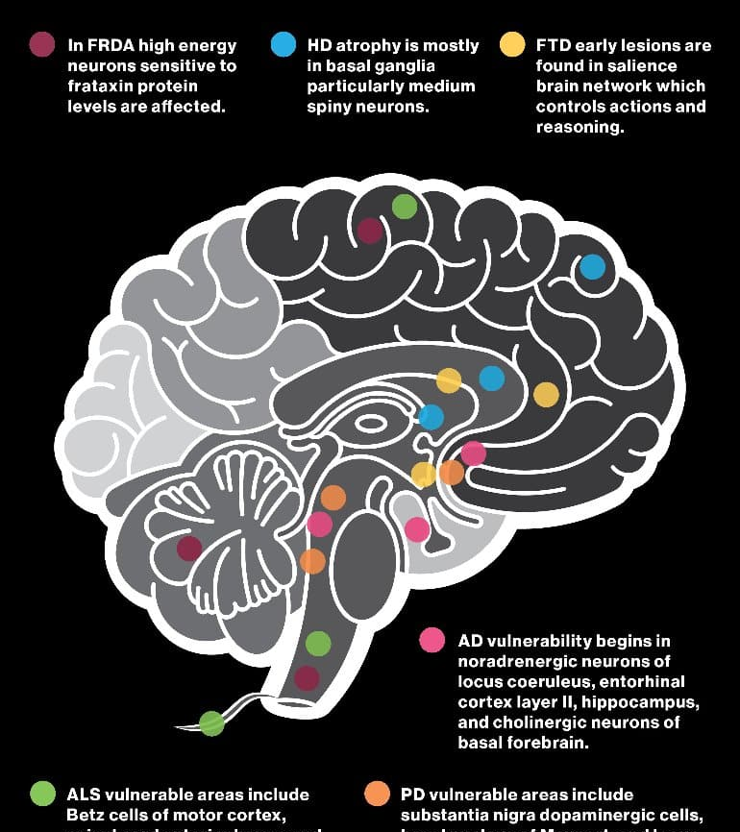
Neurodegenerative Diseases and Disorders - 7
Central and Peripheral Nervous System Diseases and Disorders.

Slide 19
Retracing the Steps of Human Ontogeny: Exploring Development from the End to the Beginning
Excerpted from: "Retracing the Steps of Human Ontogeny: Exploring Development from the End to the Beginning" - Dr. Jay Seitz (2023). Creative Commons Attribution 4.0 International License, except where otherwise noted.

