Slide 1
Neurodegenerative Disorders and Disease
- Dr. Jay Seitz

Slide 2
Neurodegenerative Disorders and Disease
Nootropics and Promnestics
Promnestic Drugs
Acetylcholinesterase inhibitors
There is slow degradation of acetylcholine in mild-to-moderate Alzheimer’s disease. So, the idea is to target cholinergic neuronal pathways that project from the basal forebrain (just in front of hypothalamus, i.e., nucleus basalis of Meynert) to the cerebral cortex and hippocampus.
Mesocortical dopamine pathways play significant role in cognitive function including verbal fluency, serial learning, vigilance for executive functioning, sustaining and focusing attention, prioritizing behavior, and modulating behavior based on social cues.
Acetylcholinesterase (AChE) and butyrylcholinesterase (BuChE) inactivate acetylcholine (ACh) at cholinergic synapses (AChE) and nearby glia (BuChE). Hence, acetylcholinesterase inhibitors.
1. Reminyl (2001) – Galantamine hydrochloride
2. Exelon (2000) – Rivastigimine tartrate
3. Aricept (1996) – Donepezil hydrochloride – fewest side effects and first line treatment
4. Cognex (1993) – Tacrine hydrochloride

Slide 3
Neurodegenerative Disorders and Disease – Table of Contents (TOC)
AI and machine learning
Cardiovascular and metabolic diseases
Type 2 diabetes
Obesity
Cognition
Core aging research
Neurodegenerative diseases
Amyloid and tau pathology
Alzheimer’s disease
Vascular dementia
Lewy-body dementia
Frontotemporal dementia
Dementia screening
b. Synuclein pathology
i. Parkinson’s disease
ii. Lewy-body dementia
Depression
Endocrinology
Evolutionary medicine
Metformin

Slide 4
Neurodegenerative Disorders and Disease (TOC)
NAD+
Neuromodulation and neurofeedback
Neuropsychological assessment
Neurotoxicants
Nootropics and promnestics
Nutrition
Blueberries
Caloric restriction
Coffee
EVOO
Intermittent fasting
Pomegranate juice
PUFAs

Slide 5
Neurodegenerative Disorders and Disease (TOC)
Resveratrols
Tart cherries
Periodontal disease
Physical exercise
Protein misfolding
Psychosomatic illness
Sleep and biorhythms
Telomeres
Neuroinflammation

Slide 6
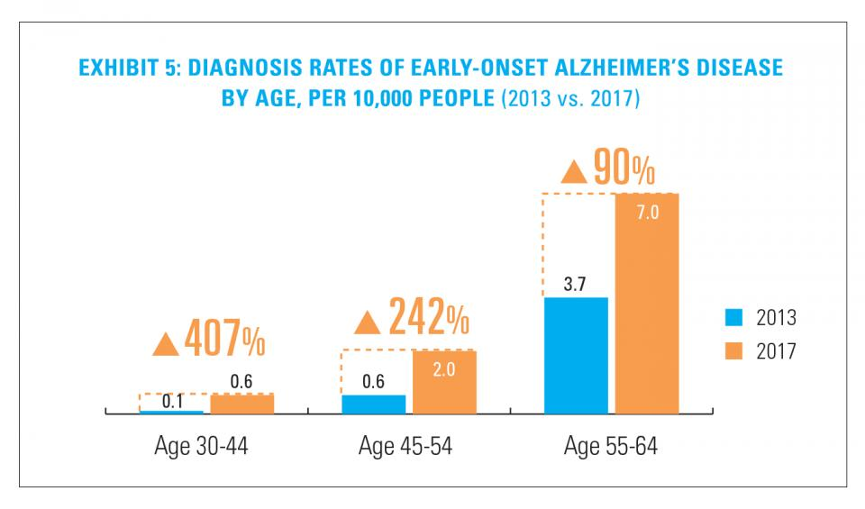
Neurodegenerative Disorders and Disease
Demographic Factors
The rate of early-onset Alzheimer's diagnosis for US adults aged 30 to 44 increased by 407% between 2013 - 2017 more than for any other age group according to data analysis released by Blue Cross/Blue Shield.
AGE DIFFERENCES

Slide 7
Neurodegenerative Disorders and Disease

Slide 8
Neurodegenerative Disorders and Disease
Comorbid conditions (e.g., depression) are common including cognitive decline in years prior to diagnosis.
“Stroke circuit” in the Southeastern states is high in sugar-sweetened beverages (SSBs), saturated fat, and high salt intake. Excess salt, sugar (hyperglycemia), and saturated fat in the diet can lead to cardiovascular problems and cerebral stroke, the so-called “stroke circuit” in seven Southern states.

Slide 9
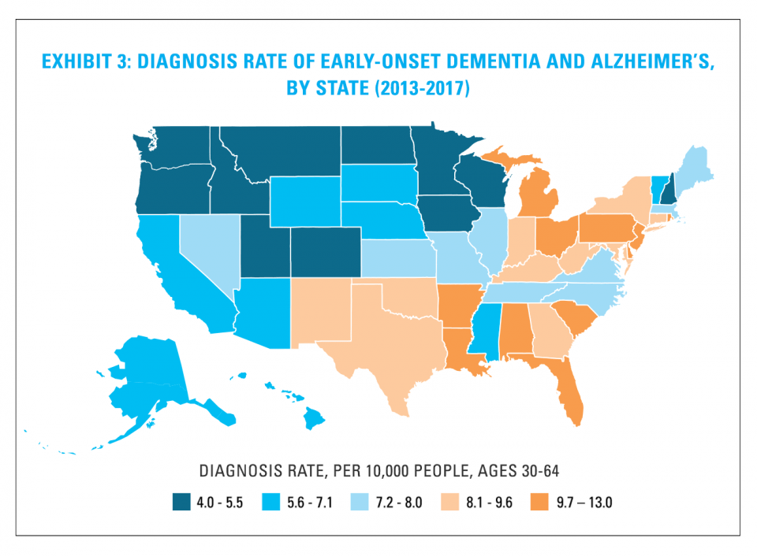
Neurodegenerative Disorders and Disease
State Differences

Slide 10
Neurodegenerative Disorders and Disease National Characteristics

Slide 11
Neurodegenerative Disorders and Disease
National differences (above)
Ethnic differences:
Current projections: By 2050 42% of adults 65 and older in the US will be members of ethnic minority groups; 85 and older have a 50% chance of contracting Alzheimer’s disease (AD).
African Americans are at higher risk for several health conditions in the U.S. such as heart disease, hypertension, type 2 diabetes and stroke, which are often chronic diseases.
And it is also true for Alzheimer’s disease, in which African Americans have two times higher incidence rates than non-Hispanic whites.

Slide 12
Neurodegenerative Disorders and Disease
However, African Americans with Alzheimer’s disease decline more slowly and have a longer survival rate compared to non-Hispanic whites.
So, why do these disparities exist, especially in Alzheimer’s disease, which isn’t typically considered a chronic disease but a progressive one, or one that worsens over time?
Some researchers attribute the gap to both societal and systemic factors related to inequities in education, socioeconomic factors (socioeconomically disadvantaged individuals, in general, are at an increased risk of developing 18 of 56 health conditions compared with more advantaged groups), and income and health care access. Other factors such as stress, diet, lifestyle, and genetics may also contribute.

Slide 13
Neurodegenerative Disorders and Disease
However, there’s a less-explored question in Alzheimer’s that could contribute to this disparity: Is the underlying biology of the disease somehow different in blacks and non-Hispanic whites?
• APOE e4 allele along with the gene, ABCA7, is now related to increased risk for AD among African Americans.

Slide 14
Neurodegenerative Disorders and Disease
GENDER DIFFERENCES
For every three (3) AD patients, two are women even when discounting for their greater longevity (about four years on average) relative to men. Menopause increases risk with postmenopausal women accounting for 60% of AD patients. Why?
In menopause, there is dysregulation of brain estrogen-regulating systems leading to disturbed sleep, memory impairment, and depression. The decline in brain estrogen in women appears to be a precipitating factor for the development of AD, but in ways not fully understood.

Slide 15
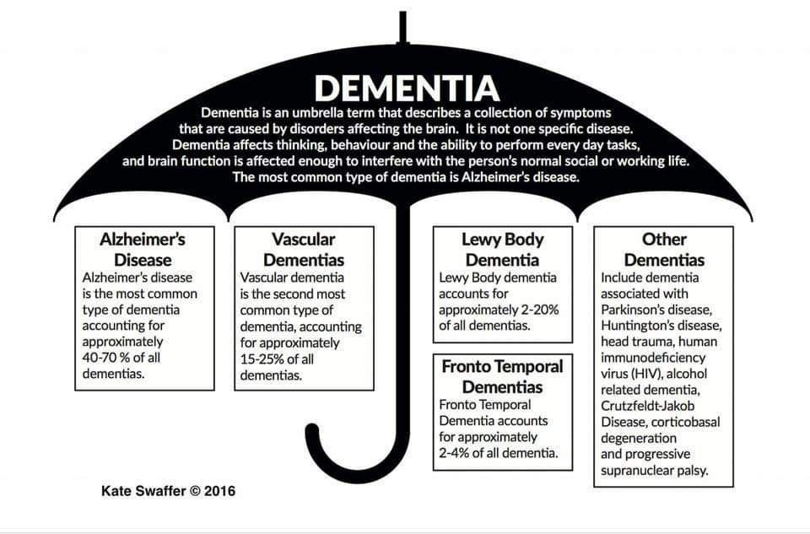
Neurodegenerative Disorders and Disease
Theories of Neurodegenerative Diseases

Slide 16
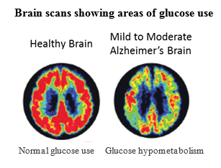
Neurodegenerative Disorders and Disease
Hypometabolism of Glucose Thesis
Extensive evidence from three decades of research has established that diminished cerebral glucose metabolism (DCGM, also known as “glucose hypometabolism”), is a key underlying pathology in the Alzheimer’s brain. In Alzheimer’s disease, DCGM occurs early, is region-specific, and correlates with other clinical features.

Slide 17
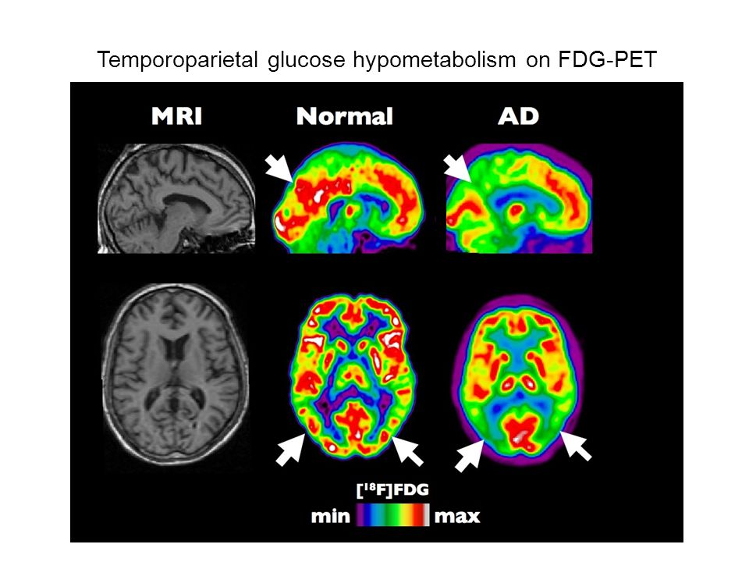
Neurodegenerative Disorders and Disease

Slide 18
Neurodegenerative Disorders and Disease
For instance, obesity is linked to AD including abnormal glucose and lipid metabolism and is associated with cerebrovascular complications. Aging itself is associated with increased adiposity (predictably, visceral fat), and increased risk for chronic diseases.
Current population projections in the US is that 50% of individuals will be obese by 2030 (BMI > 30 kg/m2) and 30% will be very severely obese (BMI > 35 kg/m2). Overall, greater than 70% of Americans are overweight (BMI = 25.0-29.9 kg/m2) or obese as of 2020.
Furthermore, a burgeoning body of evidence implicates oxidative damage to both nuclear and mitochondrial DNA as a critical mechanism in synapse disruption in AD. Our brains rely on oxidative phosphorylation for energy, but accumulation of oxidative damages is the key mechanism of aging. As we shall see, diet-induced obesity is consistently associated with cerebral amyloid pathology.

Slide 19
Neurodegenerative Disorders and Disease
Substances that boost mitochondrial function such as nicotinamide adenine dinucleotide (NAD and its metabolite, NAD+) are under investigation for brain health. NAD levels decrease with aging and are involved in age-related metabolic decline.
As it turns out, NAD+ influences a class of proteins known as sirtuins. Sirtuins (SIRT1, in particular) influence cellular processes including aging, cell death (apoptosis), inflammation, stress resistance, and energy efficiency during caloric restriction (starvation).
Metformin is a first-line medication for the treatment of type 2 diabetes (TD2M), particularly in people who are overweight. It works by decreasing glucose production in the liver and increasing the insulin sensitivity of body tissues. A 2017 review found that people with diabetes who were taking metformin had lower all-cause mortality, and it reduced cancer and cardiovascular disease compared with those on other therapies. It is being studied to see what effect it may have on aging.

Slide 20
Neurodegenerative Disorders and Disease

Slide 21
Neurodegenerative Disorders and Disease
The human body synthesizes at least 30,000 types of proteins. The multidimensional structure of proteins determines their function, but incorrect protein-folding can cause disease.
Misfolded proteins (toxic conformations) are typically insoluble and tend to form long linear or fibrillar aggregates known as amyloid deposits.
The native configuration of a protein forms an alpha helix (right-handed spiral coil), but with toxic conformational change it acquires a motif known as a beta sheet and is characteristic of amyloid deposits. Such conformational change is most likely to occur in proteins that have repetitive amino acid motifs (CAG) such as in Huntington’s disease (IT15 gene on chromosome 4; an autosomal dominant mutation).

Slide 22
Neurodegenerative Disorders and Disease
These toxic proteins repeat the cycle in a self-sustaining loop, amplifying the toxicity, as in prion proteins in spongiform encephalopathies: Bovine or mad cow disease, Creutzfeldt-Jakob disease—ingesting beef with toxic protein particles—and kuru, an epidemic human prion disease associated with cannibalistic funeral practices.

Slide 23
Neurodegenerative Disorders and Disease

Slide 24
Neurodegenerative Disorders and Disease
Misfolded Proteins Associated with Neurodegenerative Diseases
Proteinopathy | Aggregating Proteins
Alzheimer’s disease | Amyloid beta (Ab) peptide, Tau
Parkinson’s disease | Alpha-synuclein
Multiple tauopathies | Tau protein (microtubule associated)
Huntington’s disease | Huntingtin with tandem glutamine repeats
Amyotrophic lateral sclerosis (ALS) | Superoxide dismutase 1
Spongiform encephalopathies | Prion proteins
Familial amyloidotic polyneuropathy | Transthyretin (mutant forms)

Slide 25
Neurodegenerative Disorders and Disease
Amyloid beta, tau, and alpha-synuclein interfere with synaptic signaling.
Mutant tau disrupts microtubule function and neuronal transport mechanisms
Alpha-synuclein disrupts mitochondrial protein import.
Amyloid diseases such as Alzheimer’s and synuclein diseases such as Parkinson’s disease tend to form with age because of the production and accumulation of misfolded proteins that form toxic aggregates.
The cellular machinery involved in the degradation of aging proteins can be faulty: Such as the proteasome pathway—which degrades unneeded or damaged proteins by proteolysis by breaking peptide bonds—or there may be inhibition of autophagy (cell removal) that promotes amyloid aggregation. Errant proteins are also sequestered in various cellular compartments by “chaperone proteins.”

Slide 26
Neurodegenerative Disorders and Disease
There is also another pathway, the mTOR pathway, and inhibition of it stimulates the degradation of neurodegenerative disease proteins, thus stimulating autophagy. Interestingly, mTOR activators of autophagy include curcumin (in turmeric) and resveratrol (from red wine and other sources).
Resveratrol (RES: trans-3,4,5-trihyroxystilbene) is a nonflavonoid polyphenol in the stilbene group and may be partly responsible for what is known as the French paradox (ingestion of saturated fat in French cheeses and other sources, but low rates of cardiovascular disease).
RES is actuality part of a plant’s defense mechanisms. In humans, RES is neuroavailable and exerts neuroprotective effects as it may protect against NMDA-induced cell death. The NMDA receptor, one of three receptors that codes for glutamate, is very important for controlling synaptic plasticity and memory function. N-methyl-D-aspartate receptor antagonists (such as memantine) are a class of drugs that may help treat Alzheimer's disease.

Slide 27
Neurodegenerative Disorders and Disease
RES + quercetin, a plant flavanol, improves the bioavailability of RES. Both RES and pterostilbene, another stilbenoid, promote “healthspan,” weight loss, and protect against cardiovascular and neurodegenerative diseases, stroke-induced brain damage, and cancer and cancer metastasis.
Interestingly, amyloidogenic diseases include Type 2 diabetes and atherosclerosis.
But pathologies and dementias of the CNS such as Alzheimer’s and Parkinson’s diseases are also associated with tau proteins that become hyperphosphorylated into insoluble aggregates known as neurofibrillary tangles.

Slide 28
Neurodegenerative Disorders and Disease
Nonetheless, as of 2020, there have been over 300 failed trials of Alzheimer's drugs that largely target amyloid. That is, studies of anti-amyloid drugs that have been completed so far have repeatedly failed.

Slide 29
Neurodegenerative Disorders and Disease
Neuroinflammation
Do Infections Trigger Alzheimer’s Disease?
The standard model (received view) of Alzheimer’s disease (AD) postulates that the production of the amyloid-β (Aβ) peptide (peptides are short chains of amino acids), stimulates the development of tau neurofibrillary tangles (tau is a protein composed of larger chains of amino acids that stabilize axons interacting with neighboring neurons) as well as inflammation in the brain. Thus, Aβ, tau, and (neuro)inflammation have been proposed to lead to the destruction of neurons and synapses in the adult brain in AD.

Slide 30
Neurodegenerative Disorders and Disease
A newer theory suggests that infections of both the brain and body triggers the immune system in the brain and that sets off neuroinflammation.
What kind of infections? Microbes that attack the brain, known as “neurotropic microbes” include the family of herpesviruses including herpes simplex virus 1 (HSV-1) and 2 (HSV-2), which cause both cold sores and genital herpes, respectively. In the US, about half of adolescents and adults under the age of 50 are infected with HSV-1 and about 12% are infected with HSV-2. As it turns out, antivirals such as acyclovir reduce the accumulation of both Aβ and tau in the brain.

Slide 31
Neurodegenerative Disorders and Disease
But there are other neurotropic microbes linked to AD including the varicella-zoster virus (VZV) implicated in chickenpox and shingles and widespread in the US population, the hepatitis C virus implicated in liver disease, Helicobacter pylori associated with gastric ulcers, Porphyromonas gingivalis, a bacterium associated with periodontal disease, Chlamydia pneumoniae, a bacterium linked to pneumonia, as well as certain fungal infections.
But is neuroinflammation and resulting neurodegeneration a cause or a consequence of AD? That’s the 50 million individuals worldwide with AD question.

Slide 32
Neurodegenerative Disorders and Disease
What are the phases of Alzheimer’s disease?
• Preclinical and asymptomatic phase
Neuropsychological testing can reveal mild cognitive difficulties up to eight years before a person fulfills the clinical criteria for diagnosis of AD. These early symptoms can affect the most complex activities of daily living. The most noticeable deficit is short term memory loss (working memory deficits), which shows up as difficulty in remembering recently learned facts and inability to acquire new information.
• Cognitive performance decline phase
AD does not affect all memory capacities equally. Older memories of the person's life (episodic memory), facts learned (semantic memory), and implicit memory (memory how to do things) are affected to a lesser degree than new facts or memories.
Language problems are mainly characterized by a shrinking vocabulary and decreased word fluency leading to a general impoverishment of oral and written language.

Slide 33
Neurodegenerative Disorders and Disease
Memory-dominant dementia syndrome
One of the earliest structural changes in the brain is the accumulation of paraventricular (adjacent to a ventricle) and subcortical deep white matter hyperintensities (WMH).
Progressive deterioration eventually hinders independence, with subjects being unable to perform most common activities of daily living (ADLs). Speech difficulties become evident due to an inability to recall words, which leads to frequent incorrect word substitutions (paraphasias, the production of unintended syllables, words, or phrases during speaking). Reading and writing skills are also progressively lost. Complex motor sequences become less coordinated as time passes and AD progresses so the risk of falling increases. During this phase, memory problems worsen, and the person may fail to recognize close relatives. Long-term memory (LTM), which was previously intact, becomes impaired.

Slide 34
Neurodegenerative Disorders and Disease
During the final stages the patient is completely dependent on caregivers. Language is reduced to simple phrases or even single words eventually leading to complete loss of speech. Despite the loss of verbal abilities, people can often respond to clear emotional signals. Although aggressiveness can still be present, extreme apathy and exhaustion are much more common symptoms. People with AD will ultimately not be able to perform even the simplest tasks independently; muscle mass and mobility deteriorates to the point where they are bedridden and unable to feed themselves.

Slide 35
Neurodegenerative Disorders and Disease
Types of Dementia
1. Alzheimer’s disease (AD): 40-70% of cases
2. Vascular dementia (VD): 15-25% of cases
It is caused by disease or injury affecting the blood supply to the brain typically involving a series of minor strokes. The symptoms of this dementia depend on where in the brain the strokes occurred and whether the vessels are large or small.
3. Dementia with Lewy bodies (DLB): 2-20% of cases
The primary symptoms are visual hallucinations and "Parkinsonism" including tremor, cognitive rigidity, bradykinesia, and problems with balance and initiating movement such as ambulating. The visual hallucinations are of people or animals, and they often occur when someone is about to fall asleep or wake up. Other symptoms include problems with attention, organization, problem solving, planning, and difficulty with visual-spatial abilities.

Slide 36
Neurodegenerative Disorders and Disease
4. Frontotemporal dementia (FTD): 2-4% of cases
FTDs are characterized by drastic personality changes and language difficulties. There is early social withdrawal and lack of insight.
5. Progressive supranuclear palsy (PSP)
PSP is an uncommon brain disorder that affects movement, gait, balance, speech, swallowing, vision, mood, behavior, and thinking. The disease damages certain parts of the brain above nerve cell clusters called nuclei (supranuclear). These nuclei control eye movements. Thus, one of the classic signs of the disease is an inability to aim and move the eyes properly, which individuals may experience as blurring of vision.
6. Corticobasal degeneration (CBD)
CBD is a rare neurodegenerative disease involving the cerebral cortex and the basal ganglia. It is characterized by marked disorders in movement and cognition and is classified as one of the Parkinson plus syndromes (classical features of Parkinson’s disease with additional features). In the case of CBD, one common sign is difficulty using one limb. What may occur is an alien limb that seems to have a mind of its own and moves without conscious control (“alien hand syndrome”).

Slide 37
Neurodegenerative Disorders and Disease
7. Creutzfeldt–Jakob disease
Is a fatal degenerative brain disorder. Early symptoms include memory problems, behavioral changes, poor coordination, and visual disturbances. Later symptoms include dementia, involuntary movements, blindness, weakness, and coma. About 70% of people die within a year of diagnosis.
8. Encephalopathy including chronic traumatic encephalopathy (CTE)
CTE is a neurodegenerative disease caused by repeated head injuries (athletes). Symptoms may include behavioral problems, mood problems, and problems with thinking. Symptoms typically do not begin until years after the injuries. CTE often gets worse over time and can result in dementia.

Slide 38
Neurodegenerative Disorders and Disease
9. Fragile X-associated tremor/ataxia syndrome (FXTAS)
FXTAS is a late-onset neurodegenerative disorder most frequently seen in male carriers of Fragile X syndrome (FXS) over the age of
10. Fragile X syndrome has an X-linked dominant inheritance. It is typically caused by an expansion of the CGG triplet repeat within the FMR1 gene on the X chromosome.

Slide 39
Neurodegenerative Disorders and Disease
Dementia Screening
• CVLT-II (more intrusion errors)
• Episodic & semantic memory
• Block design
• Clock drawing
• Matrix reasoning - executive functions
• Lexical & category fluency (FAS and boy's names and animals)

Slide 40
Neurodegenerative Disorders and Disease
Severe Impairment Battery
Attention
Construction
Language
Memory
Orientation (in three spheres)
Praxis
Social Interaction
Visuospatial ability

Slide 41
Neurodegenerative Disorders and Disease
Neuropsychological Evaluation I
Wechsler Abbreviated Scale of Intelligence (WASI, 1999 edition)
Rey Complex Figure Test (RCFT, 1995 edition)
Hopkins Verbal Learning Test-R (HVLT-R, 2001 edition)
Wechsler Memory Scale (WMS-III, 1997 edition)
Delis-Kaplan Executive Function System (D-KEFS, 2001 edition)
Clock Drawing Test (CDT, 1992 edition)
Wisconsin Card-Sorting Test (WCST, 1993 edition)
Prospective & Incidental Memory Measures (PIMM, 2003 edition)
Boston Naming Test – Warrington Variation (BNT, 2001 edition)
Clinical evaluation of verbal and nonverbal communication; emotional and social competencies in the intrapersonal and interpersonal spheres; symbolic, cognitive, and representational capacities; visuospatial abilities, and motor skills and abilities.

Slide 42
Neurodegenerative Disorders and Disease
Neuropsychological Evaluation II
Depression: Geriatric Depression Scale, BDI-II (Beck Depression Inventory)
Apathy: Apathy Scale (orbitofrontal cortex - hypometabolism, dorsolateral prefrontal cortex – cognitive flexibility, medial temporal limbic structures - disinhibition)
Anxiety: BAI (Beck Anxiety Inventory)
Anhedonia: SHPS (Smith Hamilton Pleasure Scale)
Emotion: POMS (Profile of Mood States)
Facial prosody: FrSBe (Frontal Systems of Behavior Scale), FAB (Frontal Assessment Battery)
Affect perception/expression: NYEB (New York Emotion Battery)

Slide 43
Neurodegenerative Disorders and Disease
Endocrinology
Three hormonal systems show decreasing circulating hormone concentrations during normal aging:
Estrogen (menopause) and testosterone (andropause, male menopause or late-onset hypogonadism)
Dehydroepiandrosterone (DHEA) and its sulphate, DHEA-S (adrenopause)
Adrenopause is the decline in adrenal androgens such as DHEA and dehydroepiandrosterone sulfate (DHEA-S) manufactured in the zona reticularis, the innermost layer of the adrenal cortex. Levels of adrenal androgens start to increase around age 7 or 8 years (adrenarche), peak in early adulthood (20 to 25 years) and decrease at a rate of approximately 2% per year thereafter eventually reaching levels of 10 to 20% of those of young adults by age 80 years. It is caused by the progressive apoptosis of androgen-secreting cells and involution (shrinking) of the zona reticularis.

Slide 44
Neurodegenerative Disorders and Disease
Growth hormone/insulin-like growth factor I axis (somatopause)
Somatopause is the progressive decline in the levels of growth hormone (GH) and insulin-like growth factor 1 (IGF-1, which plays a role in growth in childhood), which are hormones of the HPS (hypothalamic-pituitary-somatotopic) axis. By 70-years-of age GH production may be only 60% of that of a young adult and results in changes to the body such as a decrease in lean body mass.
Age-related disability is characterized by generalized weakness, impaired mobility and balance, and poor endurance. It eventually results in physical frailty, a state of reduced physiological reserves associated with increased susceptibility to disability.
The two clinically most important changes in endocrine activity during aging involve the pancreas and the thyroid. Approximately 40% of individuals 65 to 74 years old, and 50% of individuals older than 80 years, have impaired glucose tolerance or diabetes mellitus, and nearly half of elderly diabetics go undiagnosed.
Age-related thyroid dysfunction is also common in the elderly. Lowered plasma thyroxine (T4) and increased thyrotropin- stimulating hormone (TSH) concentrations occur in 5 to 10% of late-age adult women. These abnormalities are mainly caused by autoimmunity and are therefore an expression of age-associated disease.

Slide 45
Neurodegenerative Disorders and Disease
Evolutionary Medicine
Hygiene hypothesis: Helminth parasites (parasitic worms) have lived inside humans for most of evolution and make a protein that downregulates Type-II immunity (Type II interferons help regulate the immune system and is known as innate immunity) and thus protects the parasites. Remove the parasites and asthma and Crohn’s disease increase.
Short telomeres protect against cancer but decrease longevity.
Diabetes and obesity are strongly correlated.

Slide 46
Neurodegenerative Disorders and Disease
What might be some newer and alternative treatments for neurodegenerative diseases?
(1) Intermittent fasting
It takes 10 to 12 hours to use up the calories in the liver before a metabolic shift occurs to using stored fat. After meals, glucose is used for energy and fat is stored in fat tissue, but during fasting, once glucose is depleted, fat is broken down and used for energy.
Animal studies have shown a “robust disease-modifying” benefit of intermittent fasting on a wide range of chronic disorders, including cancer, cardiovascular disease, diabetes, multiple sclerosis, neurodegenerative brain diseases, obesity, as well as the slowing or reversing of aging. It also improves insulin resistance, blood fat abnormalities, high blood pressure, and inflammation even independently of weight loss.

Slide 47
Neurodegenerative Disorders and Disease
Neurodegenerative diseases and disorders: Alternate-day fasting, in particular, delays onset and progression in Alzheimer’s and Parkinson’s disease. Sedentary lifestyle and overeating can lead to stroke, Alzheimer’s and Parkinson’s disease.
Likewise, alternate-day fasting and periodic cycles of three (3) consecutive days of energy restriction reduce autoimmune demyelination in multiple sclerosis.

Slide 48
Neurodegenerative Disorders and Disease
2) Caloric restriction
Aging is the highest risk factor for many human diseases, including cancer, dementia, diabetes and metabolic syndrome. Caloric restriction has been shown in animal models to be one of the most effective interventions against these age-related diseases. And although researchers know that individual cells undergo many changes as an organism ages, they do not know caloric restriction might influence these changes.
Some of the cells and genes most affected by diet relate to immunity, inflammation, and lipid metabolism. The number of immune cells in nearly every tissue studied, dramatically increased as control rats aged, but was not affected by age in rats with restricted calories. In brown adipose tissue—one type of fat tissue—a calorie-restricted diet reverted the expression levels of many anti-inflammatory genes to those seen in young animals.
In addition, the increase in the inflammatory response during aging appears to be systematically repressed by caloric restriction.

Slide 49
Neurodegenerative Disorders and Disease
(3) Physical exercise
In a major study (2019), participants included 182 clinically normal older adults from the Harvard Aging Brain Study who had an average age of 73; 57% were female.
They were initially assessed with the Preclinical Alzheimer Cognitive Composite (ADCS-PACC), which measures episodic memory (memory for events), executive functions (planning and organizing ongoing cognitive activities, monitoring these ongoing cognitive processes, holding them and manipulating them in working memory for ongoing and later use, and delegating attentional resources to the cognitive task at hand), and other global aspects of cognition (collectively, “cognitive reserve”).
Greater physical activity was linked to slower amyloid-beta (Aβ)-related cognitive decline and gray matter volume loss (“brain reserve”). Modest levels of physical activity (minimum 8,900 steps a day) were highly significant. Lower vascular risk was also related to slower cognitive decline and brain volume loss.

Slide 50
Neurodegenerative Disorders and Disease
(4) Diet and nutrition
Diet has been linked to metabolic disorders (obesity, Type II diabetes), cardiovascular outcomes, and brain health.
On any given day, nearly one-third of American adults eat at a full-service restaurant and nearly half at a fast-food restaurant. The nutritional quality of most of these meals is poor and almost none are ideal, and this is true for both quick-serve and full-service restaurants.
For people with college degrees, poor-quality meals from fast-food restaurants dropped from 74% to 60% during the study (2019). But for people without a high school diploma, 76% of fast-food meals were of poor nutritional value. Indeed, restaurants aggressively develop and promote unhealthier options to lower-income and marginalized communities and restaurant choices in these communities tend to be less healthy.
Plant-based diets are highly effective in reducing CVD as well as in halting the progression of coronary atherosclerosis.
Major takeaway point: Lifestyle make a difference.

Slide 51
Neurodegenerative Disorders and Disease
Coffee lowers risk of some cancers (prostate and liver), T2DM, metabolic syndrome, liver cirrhosis, Parkinson’s and Alzheimer’s diseases, and depression. Coffee may reduce inflammation and improve insulin sensitivity, liver enzyme levels, and endothelial function (cells that line the interior surface of blood and lymphatic vessels as well as the heart). Key active compounds in coffee include caffeine, chlorogenic acids, and the diterpenes, cafestol and kahweol.
In a 2018 study, researchers concluded that cups of both caffeinated and decaffeinated dark roast contained phenylindanes, compounds that block the proteins beta-amyloid and tau from clumping together and triggering diseases like Alzheimer's and Parkinson's.
Indeed, physical exercise and caffeine together improve working memory. Caffeine and exercise have been shown to separately improve certain aspects of cognition like attention and alertness, but the two energy boosters have been shown to work even better together.

Slide 52
Neurodegenerative Disorders and Disease
Tea, especially green tea, is a rich source of flavonoids including epicatechin, catechin, and epigallocatechin-3-gallate (EGCG). Studies have revealed that these bioactive compounds attenuate oxidative stress, relieve inflammation, and enhance endothelial (blood vessel) and cardiomyocyte (cardiac muscle) function.
Flavonols also reduce incidence of Alzheimer's disease: Flavonols (e.g., kale, spinach, tomatoes, tea, olive oil, apples, and pears) have antioxidant and anti-inflammatory properties.
After adjusting for genetic, demographic, and lifestyle factors, people who consumed the highest dietary intake of flavonols were 48% less like to develop Alzheimer's dementia than people with the least intake.

Slide 53
Neurodegenerative Disorders and Disease
EVOO (extra virgin olive oil): Monosaturated fats (predominate fat in EVOO) reduce LDL and increase HDL and decrease total cholesterol. Polyphenol-rich EVOO significantly improved HDL efflux capacity—moving HDL out of cells—and improves Type II diabetes.
Merely consuming extra virgin olive oil (EVOO) is not enough to elicit the health benefits, however. A recent study (2019) suggests that when coupled with intermittent fasting, limiting caloric intake, and physical exercise, the effects of consuming olive oil are most effective. And EVOO activates the SIRT1 (anti-aging) pathway.
There are beneficial effects of EVOO consumption on all major features of the AD phenotype (behavioral deficits, synaptic pathology, Ab and tau neuropathology along with activation of microglia and astrocytes) and it appears that autophagy activation is the mechanism underlying these biological actions.

Slide 54
Neurodegenerative Disorders and Disease
Oleocanthal is a phenylethanoid found in EVOO. It appears to be responsible for the burning sensation that occurs in the back of the throat when consuming EVOO and is an easy way to judge the extent of its content in EVOO (e.g., Consumer Labs has found high rates of oleocanthal in Colavita EVOO).
Why is it important? It has anti-inflammatory and antioxidant properties, and it may be partly responsible for the low incidence of cardiovascular disease and neurodegenerative disorders (particularly, AD) associated with Mediterranean diets. It may also reduce the accumulation of B-amyloid proteins found in neurodegenerative diseases as well as reduce inflammatory degenerative joint disease.

Slide 55
Neurodegenerative Disorders and Disease
Nuts (almonds, walnuts, hazelnuts, Brazil nuts, pistachios, pine nuts, pecans, and peanuts) are predominantly unsaturated fatty acids and contain mostly oleic acid, which is beneficial for T2DM, improves glycemic control, lowers prevalence of metabolic syndrome, lowers LDL and CVD outcomes, as well as has a 49% reduction in stroke.
Dark-green vegetables (arugula, mesclun, Swiss chard, celery, collard greens, green beans, kale, and spinach) reduce arterial stiffness, blood pressure, and enrich inorganic nitrate (NO which converts to nitric oxide; NO is a gaseous signaling molecule and a key vertebrate biological messenger playing a role in a variety of biological processes).
These dark-green vegetables are high in lutein and reduce atherosclerosis and CVD risk as well as T2DM. Broccoli, brussels sprouts, collard greens, kale, and kohlrabi protect against myocardial oxidative damage. There are also reductions in LDL levels and LDL oxidation.

Slide 56
Neurodegenerative Disorders and Disease
Anthocyanins (blueberries, blackberries, black currants, cherries, cranberries, raspberries, strawberries, pomegranates, red cabbage, red radishes, and eggplant) lower MI risk (myocardial infarction) but high-dose antioxidant supplements have not demonstrated benefits. These antioxidants may be beneficial at low doses but harmful at high doses, a situation known as "hormosis." Anthocyanins are a big part of the MIND diet.
Blueberries reduce both systolic and diastolic blood pressure. A daily intake of one (1) cup of blueberries (364 gm) for six months improved endothelial function, mitigated systemic arterial stiffness, and elevated HDL cholesterol. Thus, vascular function and lipid status were improved. Other studies have shown it improves object recognition, at least in rodents.

Slide 57
Neurodegenerative Disorders and Disease
Pomegranates improved verbal and visual memory of middle-age adults (mean age = 62.6) after 4 weeks of 8 ounces of pomegranate juice daily. At 4 weeks only the pomegranate group significantly improved on the Buschke selective reminding test, a test of verbal memory. This test starts with free recall of 12 words and then cued recall for words not initially recalled (hence, “selective”) up to 10 trials. So, the initial free call evaluates working or short-term memory (frontal lobe) and the cued recall evaluates consolidation of long-term memory items by way of the hippocampus. fMRI showed activation in the temporal lobe on BOLD (blood oxygen level dependent) imaging after pomegranate administration. Temporal lobe systems are critical in age-related memory decline and AD.
They also evaluated mid-age adults on a spatial navigation task to measure visual memory, which also improved. Peripheral measures of plasma Trolox-equivalent antioxidant capacity (TEAC) and urolithin A-glucuronide (biomarkers for pomegranate metabolites) were recorded to be sure participants were imbibing pomegranate juice daily.

Slide 58
Neurodegenerative Disorders and Disease
In another related study, pomegranate administration to middle-aged adults improved visual memory on the Brief Visual Memory Test (BVMT-R). Subjects were presented with six geometric designs in a 2 x 3 array for 10 seconds. They are then asked to draw as many figures as possible from memory (immediate recall). A delayed trial is administered 25 minutes later (delayed recall). This is followed by a test of recognition memory in which the respondent is asked to identify which of 12 figures were included among the originals.
Interestingly, the gut microbiome breaks down pomegranate polyphenols to produce urolithins that cross the blood-brain barrier. Pomegranates have anti-inflammatory and anti-amyloid effects.
Other studies have shown improvements in cerebral blood flow in rats after administration of black cumin oil, flavanol rich cocoa, and other antioxidants.

Slide 59
Neurodegenerative Disorders and Disease
Tart cherries appear to reduce stroke incidence. Montmorency tart cherries have positive effects on cardiovascular health and reduce associated risk factors including diabetes and high cholesterol. They also lowered blood pressure and significantly improved balance and coordination in rats.
Diet-induced thermogenesis: The body uses more than twice as much energy to digest breakfast than dinner. We have long known that eating breakfast is important for health. Benefits include a healthier weight, keeping blood sugar steady, better concentration at school and work, and even heart health. A new study shows that our body is 'rev-ed' up in the morning and has a better metabolic response to breakfast than other times of the day.

Slide 60
Neurodegenerative Disorders and Disease
Fish oil supplementation
Retrospective study of fish oil supplement (FOS) use in Caucasian men and women in their 70s and 80s (Normal, MCI, AD).
Subjects had lower mean scores on the Alzheimer’s Disease Assessment Scale (ADAS, cognitive subscale, 70-point scale) and higher scores on the Mini-Mental State Examination (MMSE, 30-point scale). FOS use was only associated with those individuals who were APOE e4- negative.
There was less brain atrophy in a number of key brain areas: Cerebral cortex grey matter volume (MCI, minimal cognitive impairment group), hippocampal volume (AD, Alzheimer’s disease group), and increased ventricular volume.
Overall: Those who were regular users of FOS was associated with less cerebral cortex gray matter and hippocampal atrophy and better performance on the ADAS-cog and the MMSE.

Slide 61
Neurodegenerative Disorders and Disease
(5) Therapeutics interventions
Mindfulness as a treatment for hypertension: Roughly a third of all adults in the United States have high blood pressure, a major risk factor for heart disease and stroke. It’s a condition that can be largely controlled with diet, exercise, and medication, yet the Centers for Disease Control and Prevention estimates that only about half of the 75 million people who have high blood pressure manage to keep it in check.
During mindfulness meditation, brain activity may inhibit the stress response, in part, by acting on the adrenal medulla.
Hearing loss is now known to be the largest modifiable risk factor for developing dementia, exceeding that of smoking, high blood pressure, lack of exercise and social isolation.

Slide 62
Neurodegenerative Disorders and Disease
Periodontal disease
Porphyromonas gingivalis, the key pathogen in chronic periodontitis (CP), was identified in the brain of Alzheimer’s disease patients. Toxic proteases (a protease is an enzyme that catalyzes the breakdown of proteins into polypeptides and individual amino acids) from a bacterium called gingipains were identified in the brain of Alzheimer’s patients and the levels correlated with tau and ubiquitin pathology (ubiquitin is a regulatory protein).
Oral P. gingivalis infection in mice resulted in brain colonization and increased production of Aβ1–42, a component of amyloid plaques. Further, gingipains were neurotoxic in vivo and in vitro, exerting detrimental effects on tau, a protein needed for normal neuronal function.
A prospective observational study of AD patients with active CP reported a notable decline in cognition assessed using the Alzheimer’s Disease Assessment Scale and the Mini Mental State Examination. The study was done over a 6-month period and compared to AD patients without active CP.

Slide 63
Neurodegenerative Disorders and Disease
Physical exercise
“In order for man to succeed in life, God provided him with two means, education and physical activity. Not separately, one for the soul and the other for the body, but for the two together. With these two means, man can attain perfection.” – Plato
Benefits of exercise
1. Strengthens cardiovascular system
2. Regulates insulin in the body
a. Insulin levels drop with age increasing glucose levels putting system at risk for stroke and Alzheimer’s disease
3. Reduces obesity
4. Elevates stress threshold
5. Lifts mood
6. Boosts immune system
a. Most consistent risk factor for cancer is lack of activity
7. Fortifies the bones
b. Women reach peak bone mass at 30 and by 60, 30% reduction (1% a year)
8. Boosts motivation
9. Fosters neuroplasticity

Slide 64
Neurodegenerative Disorders and Disease
Types of exercise
1. Low-intensity: walking
2. Moderate-intensity: jogging
3. High-intensity: running
a. 55%, 65%, 75%, 90%: 85 bpm, 100, 116, 139 (220 – age) so 75 - 90% = 116 – 139 bpm
4. Interval training improves learning ability
5. Strength Conditioning: Moderate weights more effective than heavy weights in older women
6. Reward deficiency syndrome: Dopamine variation in some individuals

Slide 65
Neurodegenerative Disorders and Disease
Value of exercise
Improves alertness, attention, and motivation; encourages neurons to bind together and thus facilitates information storage; facilitates the development of new neurons arising from stem cells in the hippocampus and improves cognitive flexibility and executive function.
Exercise provides distraction, it reduces muscle tension, it builds brain resources (serotonin, norepinephrine, GABA, and BDNF), teaches a different outcome for SNS (sympathetic nervous system) activation thus rerouting brain circuits, it increases self-mastery and resilience, and increases active coping or doing something in response to whatever danger or problem is causing anxiety.
Clinical anxiety: 40 million affected in the US
Aerobic exercise and yoga are quite effective; exercise training can reduce more than 50% of the symptoms of anxiety. As we increase our heart rate and breathing in physical exercise, we learn that these physical signs don’t necessarily lead to an anxiety attack.

Slide 66
Neurodegenerative Disorders and Disease
Marijuana, exercise, and chocolate all activate the same receptors (for anandamide and 2-arachidonoylglycerol).
Exercise reduces nausea, fatigue, joint and muscle pain, and fat accumulation.
Exercise offsets decline in women post-menopausal. Cognitive decline and all neurodegenerative diseases stem from dysfunctional and dying neurons: Those who exercised at least twice a week were 50% less likely to have dementia.

Slide 67
Neurodegenerative Disorders and Disease
Biology of exercise
BDNF: Brain-derived neurotrophic factor - Builds and maintains cell circuitry.
IGF-1: Insulin-like growth factor - A hormone released by the muscles during physical activity working with insulin to bring glucose into the cells; in the brain it increases serotonin and glutamate facilitating memory and learning.
VEGF: Vascular endothelial growth factor - Builds up more capillaries in the brain and body facilitating oxygen absorption.
FGF-2: Fibroblast growth factor - Instrumental in the body for abetting tissue growth and in the brain for facilitating long-term potentiation (LTP, a dynamic mechanism that strengthens the affinity between neurons and facilitates memory consolidation).
ANP: Atrial natriuretic peptide - Produced by muscle tissue in the heart and tempers the stress response by tamping down the HPA axis. ANP increases as heart rate increase as in physical exercise.

Slide 68
Neurodegenerative Disorders and Disease
Nootropics and Promnestics
Promnestic Drugs
Acetylcholinesterase inhibitors
There is slow degradation of acetylcholine in mild-to-moderate Alzheimer’s disease. So, the idea is to target cholinergic neuronal pathways that project from the basal forebrain (just in front of hypothalamus, i.e., nucleus basalis of Meynert) to the cerebral cortex and hippocampus.
Mesocortical dopamine pathways play a significant role in cognitive function including verbal fluency, serial learning, vigilance for executive functioning, sustaining and focusing attention, prioritizing behavior, and modulating behavior based on social cues.
Acetylcholinesterase (AChE) and butyrylcholinesterase (BuChE) inactivate acetylcholine (ACh) at cholinergic synapses (AChE) and nearby glia (BuChE). Hence, acetylcholinesterase inhibitors.
1. Reminyl (2001) – Galantamine hydrochloride
2. Exelon (2000) – Rivastigimine tartrate
3. Aricept (1996) – Donepezil hydrochloride – fewest side effects and first line treatment
4. Cognex (1993) – Tacrine hydrochloride

Slide 69
Neurodegenerative Disorders and Disease
The muscarinic Ach receptor M1 is the key receptor that mediates memory functions in cholinergic neurotransmission in cerebral cortical sites.
A “cholinergic deficiency syndrome” due to degeneration of the nucleus basalis appears to be partly responsible for short-term memory problems in normal aging or mild cognitive impairment.
Inhibitors of caspase enzymes may prevent apoptosis of cholinergic neurons (caspase inhibitors). Caspases (about a dozen in humans) are a family of protease enzymes that are involved in programmed cell death (apoptosis).
Noncholinesterase inhibition may also be effective because nicotinic cholinergic receptors stimulated by smoking appear to lower the risk of Alzheimer’s disease. Nicotine stimulates nicotinic cholinergic receptors, which project to the dopaminergic cells in the mesolimbic dopamine pathway. However, nicotine shuts down the nicotinic receptor after binding to it preventing nicotine or acetycholine from further stimulating it. Therefore, nicotine’s psychopharmacological effects may be self-regulating.

Slide 70
Neurodegenerative Disorders and Disease
In Alzheimer’s disease, neuritic plaques with beta the amyloid core apolipoprotein A (APO-A), and neurofibrillary tangles of abnormally phosphorylated tau proteins, form in the cholinergic neurons of the nucleus basalis.
Neurofibrillary tangles consist of chemically altered tau proteins that impair transport of molecules in the axons of cholinergic neurons. Thus, Alzheimer’s disease is a disorder in which beta amyloid deposition destroys neurons. Some patients may have an abnormality in DNA that codes for amyloid precursor protein (APP) or APO-E, a protein that binds to and removes beta amyloid that is abnormal.
Chromosome 19 codes for APO-E and is linked to late-onset Alzheimer’s disease. Mutations on chromosomes 1, 14, and 21 can cause early-onset Alzheimer’s. Chromosome 21 is also the same gene involved with Down’s syndrome (trisomy 21) and virtually all persons with Down’s syndrome develop Alzheimer’s if they live past 50 years of age.

Slide 71
Neurodegenerative Disorders and Disease
Chromosomes 14 and 1 are associated with the genes, presenilin 1 and 2, respectively. These genes may have an effect on membrane ion channels, intracellular protein transport, and cellular differentiation.
There is initially substantial improvement in 25% of patients treated with cholinesterase inhibitors compared to 8-10% with a placebo, but the effects appear to be only temporary.
NDMA receptor antagonists
N-methyl-D-aspartate receptor antagonists prevent activation of NDMA receptors (by binding to NMDA receptors) by the excitatory neurotransmitter glutamate in moderate-to-severe Alzheimer’s disease.
1. Namenda (2004) – Memantine hydrochloride: Too much neurotransmission (glutamate) may result in diseases such as Alzheimer’s disease and Parkinson’s disease.

Slide 72
Neurodegenerative Disorders and Disease
Nootropic Drugs
Nootropic drugs purportedly enhance learning acquisition, reverse learning impairments, and have neuroprotective effects.
1. Vinpocetine
2. Piracetam
3. Caffeine
4. Phosphatidylserine (Soy-PS)
Vinpocetine as a potential tool for the treatment of stroke, as well as its neuroprotective effects. The effect of vinpocetine on infarct volume (obtained by 2,3,5-triphenyltetrazolium-chloride staining) was studied in permanent middle cerebral artery occlusion (MCAO) in rats (3 mg/kg i.p., 30 min postischemia). Vinpocetine treatment significantly decreased infarct volume (by 42%, p < 0.05) compared to control. Vinpocetine dose-dependently inhibited prolonged (24 h) or transient (15 min) glutamate and transient N-methyl-D-aspartate (NMDA) induced excitotoxicity.

Slide 73
Neurodegenerative Disorders and Disease
Piracetam-like compounds are divided into three subgroups based on their chemical structures, known efficacy, and intended clinical uses. Subgroup 1 drugs include piracetam, oxiracetam, aniracetam, pramiracetam and phenylpiracetam.
Pramiracetam reportedly improved cognitive deficits associated with traumatic brain injuries.
Although piracetam exhibited no long-term benefits for the treatment of mild cognitive impairments, recent studies demonstrated its neuroprotective effect when used during coronary bypass surgery. It was also effective in the treatment of cognitive disorders of cerebrovascular and traumatic origins; however, its overall effect on lowering depression and anxiety was higher than improving memory. As add-on therapy, it appears to benefit individuals with myoclonus epilepsy and tardive dyskinesia.

Slide 74
Neurodegenerative Disorders and Disease
Phenylpiracetam is more potent than piracetam and is used for a wider range of indications. In combination with a vasodilator drug, piracetam appeared to have an additive beneficial effect on various cognitive disabilities.
Subgroup 2 drugs include levetiracetam, seletracetam and brivaracetam, which demonstrate antiepileptic activity, although their cognitive effects are unclear.
Subgroup 3 drugs includes piracetam derivatives with unknown clinical efficacies and of these, nefiracetam failed to improve cognition in post-stroke patients and rolipram is currently in clinical trials as an antidepressant.

Slide 75
Neurodegenerative Disorders and Disease
Caffeine is a central nervous system (CNS) stimulant of the methylxanthine class. There are several known mechanisms of action to explain the effects of caffeine. The most prominent is that it reversibly blocks the action of adenosine on its receptor and consequently prevents the onset of drowsiness induced by adenosine. Caffeine also stimulates certain portions of the autonomic nervous system.
Caffeine is a central nervous system stimulant that reduces fatigue and drowsiness. At normal doses, caffeine has variable effects on learning and memory, but it generally improves reaction time, wakefulness, concentration, and motor coordination.
Caffeine is a proven ergogenic aid in humans. Caffeine improves athletic performance in aerobic (especially endurance sports) and anaerobic conditions. Moderate doses of caffeine (around 5 mg/kg) can improve sprint performance, cycling, and running time trial performance, endurance (it delays the onset of muscle fatigue and central fatigue), and cycling power output. Caffeine increases basal metabolic rate in adults.

Slide 76
Neurodegenerative Disorders and Disease
Phosphatidylserine (Soy-PS)
A double-blind, randomized controlled study was conducted to investigate the effects of Soy-PS on the cognitive functions of the middle-age Japanese subjects with memory complaints. Seventy-eight middle-aged subjects with mild cognitive impairment (50–69 years old) were randomly allocated to take Soy-PS (100 mg, 300 mg/day) or a placebo for 6 months.
Neuropsychological test scores were similarly increased in all groups including the placebo group. However, in the subjects with relatively low scores at baseline, the memory scores in PS treated groups were significantly increased against the baseline, while those of placebo group remained unchanged. And the memory improvements in Soy-PS-treated groups were mostly attributed to the increase in delayed verbal recall, a memory ability attenuated in the earliest stage of dementia.

Slide 77
Neurodegenerative Disorders and Disease
Prefrontal noradrenergic pathways that project to the frontal cortex play a significant role in sustaining and focusing attention as well as mediating energy, fatigue, motivation, and interest.
Attention is enhanced with stimulants such as methylphenidate and d-amphetamine (or l- or d,l-) as well as alpha 2 agonists such as clonidine or guanfacine (Tenex, antiadrenergic), the dopaminergic and pronoradrenergic antidepressant, bupropion (noreprinephrine and dopamine reuptake inhibitor or NDRI), and the noradrenergic selective reuptake inhibitor, reboxetine.

Slide 78
Neurodegenerative Disorders and Disease
Hyperactivity and impulsivity are mediated by the nigrostriatal dopamine pathway. Glutamatergic input from the cortex acts as an inhibitory input to the striatum suppressing obsessions, compulsions, and impulses.
The nigrostriatal dopamine pathway projects from the substantia nigra to the basal ganglia (part of the extrapyramidal system that is tied to involuntary movement opposed to the pyramidal tracts from the motor cortex) and controls movement. Dopamine deficiency can produce akathisia (restlessness) and dystonia (twisting movements of the face and neck).

Slide 79
Neurodegenerative Disorders and Disease
Sleep and Biorhythms
Human performance is modulated by circadian rhythmicity and homeostatic sleep pressure (the balance between sleeping and waking).
Cognition deteriorates rapidly and substantially when wakefulness is extended into the night and early morning hours, known as accrued sleep debt—sleep deprivation—and circadian misalignment.

Slide 80
Neurodegenerative Disorders and Disease

Slide 81
Neurodegenerative Disorders and Disease
Subcortical areas of the brain exhibit a circadian modulation that closely follows the melatonin profile.
People over age 60 with prolonged sleep (8-10 hours or more) have a 33% increased risk of all-cause mortality and 43% increased risk of cardiovascular diseases, while those with short sleep (less than 7 hours) have a 6% increased risk of all-cause mortality.
Sleep disorders, including sleep apnea, insomnia, or periodic limb movements, occur more commonly in late-age adults impacting sleep quality and duration.

Slide 82
Neurodegenerative Disorders and Disease
Telomeres
A telomere is a region of repetitive nucleotide sequences at each end of a chromosome that protects the end of the chromosome from deterioration or from fusion with neighboring chromosomes.
Over time, due to each cell division, the telomere ends become shorter.
Telomere shortening is associated with aging, mortality, and aging-related diseases.
The age of a father plays a role in the length of a child’s telomeres, which has evolutionary implications. Shorter telomeres are theorized to impose lower energy costs due to less replication, but also have immune system-related and other aging- and disease-related costs so that the effect of paternal age on telomere length may be an adaptation to increase the chances of the child’s survival.

Slide 83
Neurodegenerative Disorders and Disease

Slide 84
Neurodegenerative Disorders and Disease
MIND Diet
Recent research has suggested that the MIND diet is more effective at reducing cognitive decline than either the Mediterranean or DASH diets and may also have neuroprotective effects.
Green, leafy vegetables: At least six servings a week
Other vegetables: At least once a day
Nuts/seeds: Five servings a week (like walnuts, almonds, natural peanut butter, pomegranate and sunflower seeds)
Berries: Two or more servings a week (like blueberries, raspberries)
Beans: At least three servings a week (like soybeans, chickpeas, lentil)
Whole grains: Three or more servings a day (like oatmeal, rice, barley, quinoa)
Fish: 2-3 times a week (fatty fish, like salmon or mackerel)
Extra virgin olive oil (EVOO): Use as main cooking oil
Wine: One glass a day (preferably red like a Cote d’Rhone from Southwestern France)

Slide 85
Neurodegenerative Disorders and Disease
Flavanols are derivatives of flavans that possess a 2-phenyl-3,4-dihydro-2H-chromen-3-ol skeleton. These compounds include catechin, epicatechin gallate, epigallocatechin, epigallocatechin gallate, proanthocyanidins, theaflavins, and thearubigins.
Flavonols are a class of flavonoids that have the 3-hydroxyflavone backbone. They are present in a wide variety of fruits and vegetables. They include fisetin and quercetin, among many others.
Anthocyanins are a class of flavonoids.

